Slide 1
5. Correlation

Slide 2
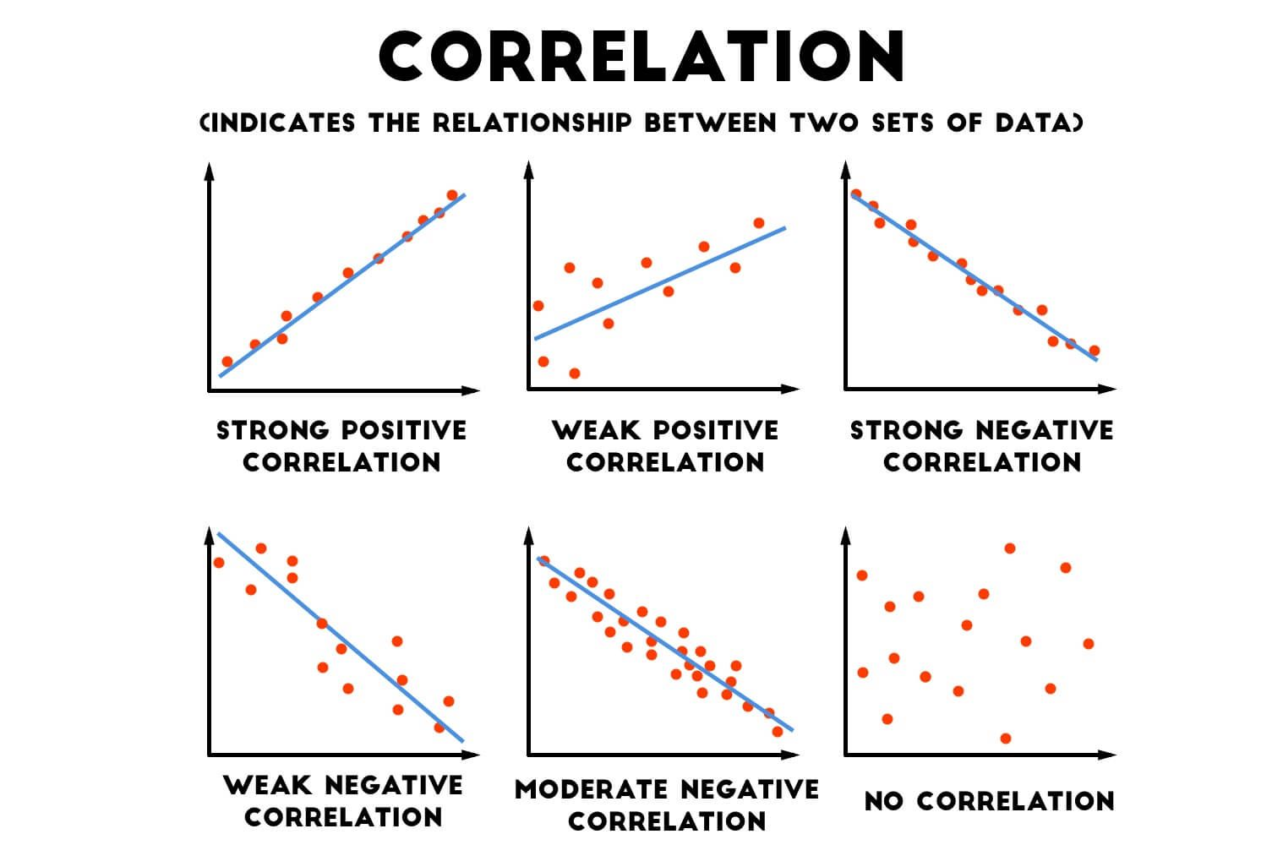
Correlation
Correlation is statistical concept that measures the degree to which two variables are associated with each other.
It quantifies the strength and direction of the linear relationship between the two variables
Strength would mean the numerical value (coefficient of correlation) that ranges between -1 to 1. A positive correlation showcases a strong positive relation meaning if one variable increases than the other variable would also increase and vice-versa. A negative correlation (-1) indicates strong negative relation meaning id one variable increases than the other variable decreases. A zero correlation would mean that the variables have no relationship

Slide 3
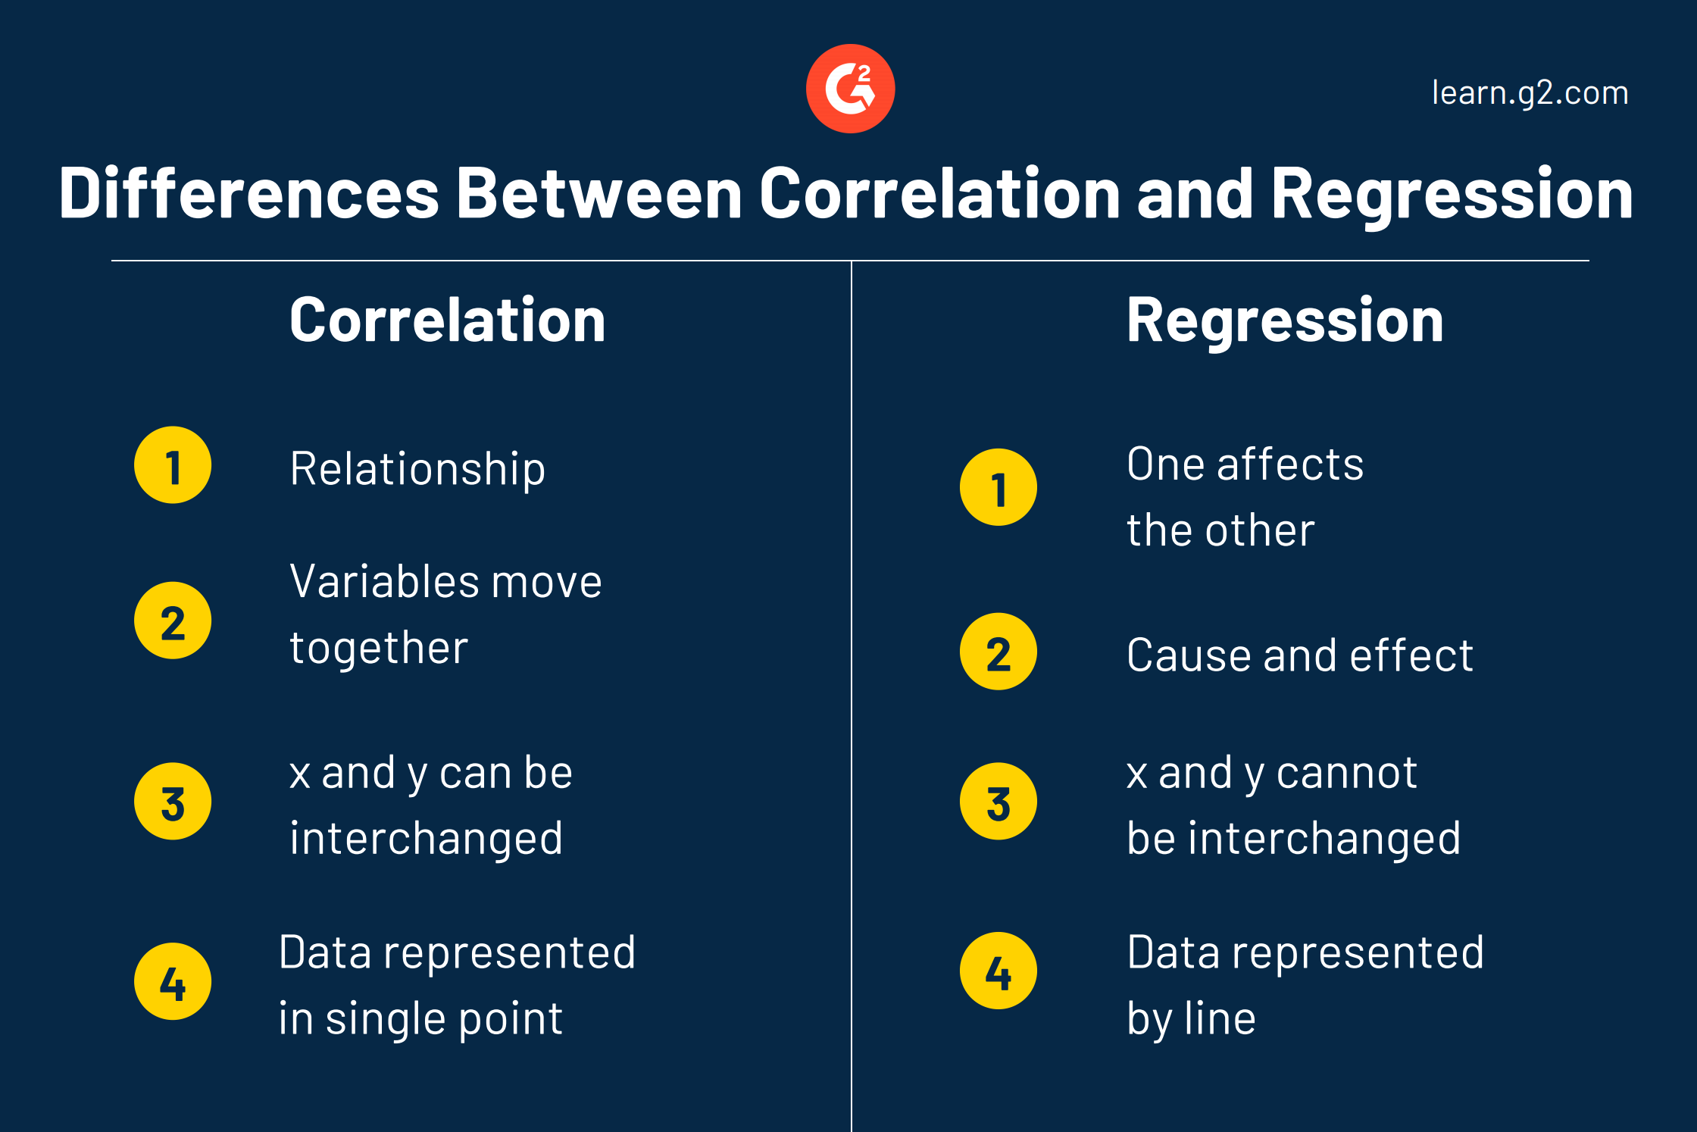
Correlation vs Regression

Slide 4
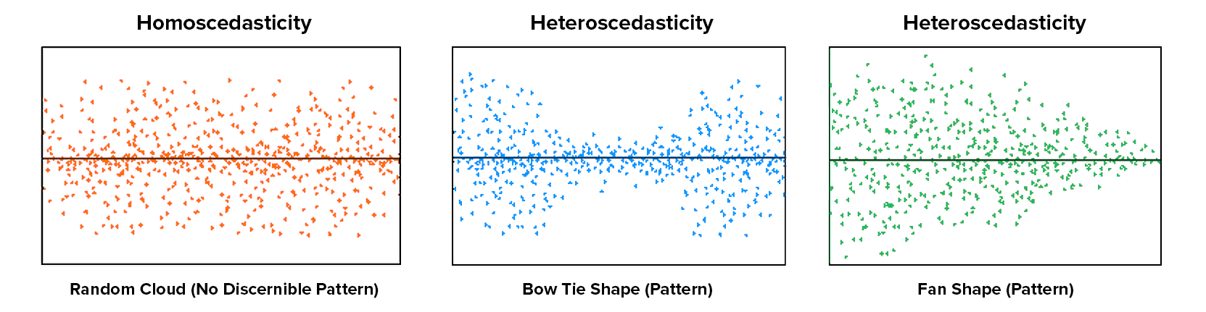
Assumptions of Linear Regression
The relation between the dependent and independent variables should be linear.
Mean of residuals should be zero or close to 0 as much as possible. It is done to check whether our line is actually the line of "best fit".
There should be homoscedasticity or equal variance in a regression model.
There should not be multicollinearity in regression model.

Slide 5

Multicollinearity
Multicollinearity occurs when independent variables in a regression model are correlated. This correlation is a problem because independent variables should be independent.
If the degree of correlation between variables is high enough, it can cause problems when you fit the model and interpret the results.
Variance inflation factor (VlF) detects multicollinearity. A rule of thumb for interpreting the variance inflation factor:
1= not correlated
Between 1 and 5=moderately correlated
Greater than 5= highly correlated.
R² is the coefficient of determination

Slide 6
Example of BELSOMRA (Correlation)
Variables | NRx | Display | Organic Search | Paid Search | Social | Samples | Voucher | Details | NRx Lag | NPP Eng
NRx | 1.00 | 0.34 | 0.90 | 0.83 | 0.61 | 0.76 | 0.59 | 0.87 | 0.97 | 0.84
Display | 0.34 | 1.00 | 0.37 | 0.61 | 0.78 | 0.35 | 0.21 | 0.35 | 0.24 | 0.31
Organic Search | 0.90 | 0.37 | 1.00 | 0.80 | 0.63 | 0.69 | 0.55 | 0.76 | 0.86 | 0.74
Paid Search | 0.83 | 0.61 | 0.80 | 1.00 | 0.79 | 0.68 | 0.51 | 0.76 | 0.75 | 0.74
Social | 0.61 | 0.78 | 0.63 | 0.79 | 1.00 | 0.54 | 0.43 | 0.58 | 0.49 | 0.48
Samples | 0.76 | 0.35 | 0.69 | 0.68 | 0.54 | 1.00 | 0.40 | 0.78 | 0.73 | 0.69
Voucher | 0.59 | 0.21 | 0.55 | 0.51 | 0.43 | 0.40 | 1.00 | 0.55 | 0.58 | 0.51
Details | 0.87 | 0.35 | 0.76 | 0.76 | 0.58 | 0.78 | 0.55 | 1.00 | 0.84 | 0.81
NRx Lag | 0.97 | 0.24 | 0.86 | 0.75 | 0.49 | 0.73 | 0.58 | 0.84 | 1.00 | 0.85
NPP Eng | 0.84 | 0.31 | 0.74 | 0.74 | 0.48 | 0.69 | 0.51 | 0.81 | 0.85 | 1.00
The above examples show cases that the NRx is high correlated with all the variables except display (voucher and social are moderately correlated)
We can also see the other variables except NRx are also correlated with the other variables

Slide 7
Appendix

Slide 8
Issues and Solutions with Multicollinearity
Below are the issues while modeling with variables
The coefficient estimates can swing wildly based on which other independent variables are kept in the model. The coefficients become very sensitive to very small changes in the model.
Multicollinearity reduces the precision of the estimated coefficients, which weakens the statistical power of your regression model. You might not be able to trust the p-values to identify independent variables that are statistically significant
Probable solutions that can used to resolve the multicollinearity issue –
Remove some of the highly correlated independent variables.
Linearly combine the independent variables, such as adding them together and include them in the model
Perform an analysis designed for highly correlated variables, such as principal components analysis or partial least squares regression.
LASSO and Ridge regression are advanced forms of regression analysis that can handle multicollinearity.

Slide 9
Example of BELSOMRA (Multicollinearity)
Variable | DF | Estimate | StdErr | tValue | P-Value | Variance Inflation
Intercept |  | -1267.26 | 50.01 | -25.34 | 0.00 | 0.00
hcc_osrch_sessions | 1 | 0.34 | 0.03 | 13.47 | 0.00 | 8.79
hcc_psrch_clk | 1 | 0.13 | 0.01 | 24.93 | 0.00 | 8.45
hcc_soc_imp | 1 | 0.00 | 0.00 | 12.79 | 0.00 | 7.16
hcp_disp_imp | 1 | 0.00 | 0.00 | -0.17 | 0.86 | 1.43
hcp_grail_nrx_lag | 1 | 0.75 | 0.01 | 104.71 | 0.00 | 11.95
hcp_grail_sdot | 1 | 0.00 | 0.00 | 3.89 | 0.00 | 3.25
hcp_grail_vnrx | 1 | 0.09 | 0.10 | 0.96 | 0.33 | 1.70
hcp_npp_eng | 1 | -0.07 | 0.00 | -14.87 | 0.00 | 6.52
hcp_osrch_sessions | 1 | -0.94 | 0.14 | -6.86 | 0.00 | 6.86
hcp_rdtl_totdet | 1 | 0.06 | 0.01 | 8.37 | 0.00 | 6.24
We can observe the consumer channel variables show high VIF’s values (> 5) that makes not a fit model.

